Slide 1
2016 Iowa Alcohol
Sales Projections
Philip Bradfield

Slide 2
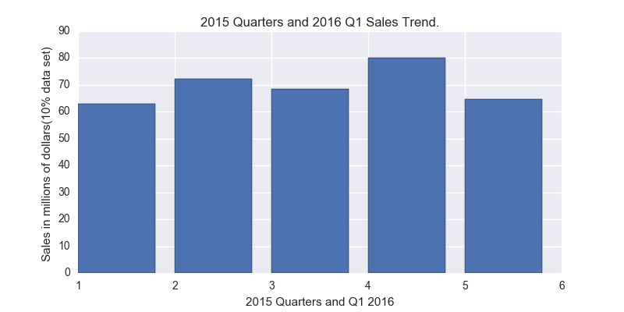
2015 Alcohol Sales Trend
(beer and wine not included).

Slide 3
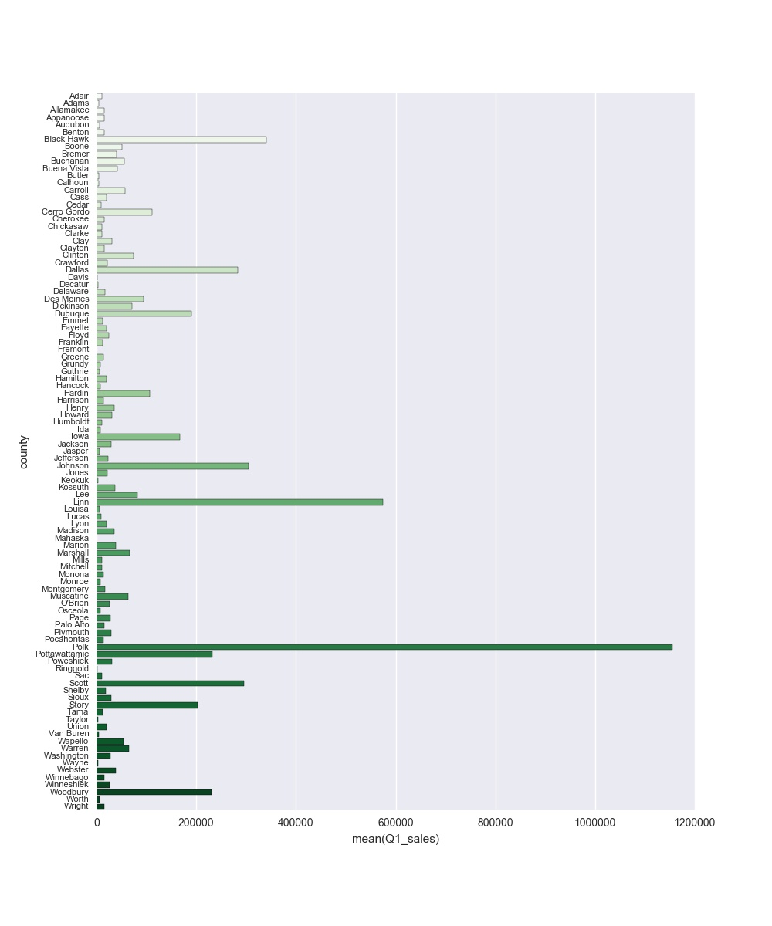

Slide 4
Growth in sales at rate of 3.4% to 4.8%
Total sales in 2015 was approximately
$278,000.00
Projected range for total sales for 2016 is
$287,000,000 to $291,500.000

Slide 5
Considerations:
Population of those over 2016 remains the same. (2014 Iowa pop. growth was only 0.5% - ‘DR’ )
Economy remains stable. (Iowa’s economic growth was slightly negative in the first part of 2015 - ‘DR’)
Prices on alcohol remain the same. (Strong USD)
No presidential politics in 2017

Slide 6
2016 Alcohol Sales Projection for Iowa
Projected range for total sales for 2016 is
$287,000,000 to $291,500.000

